Slide 1
Control rectifiers with R,L,C loads

Slide 2
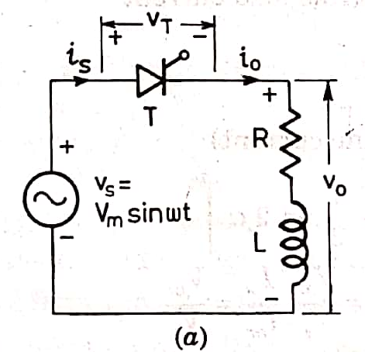
Single-phase Half-wave Circuit with RL Load
A single-phase half-wave thyristor circuit with RL load is shown in Fig.

Slide 3
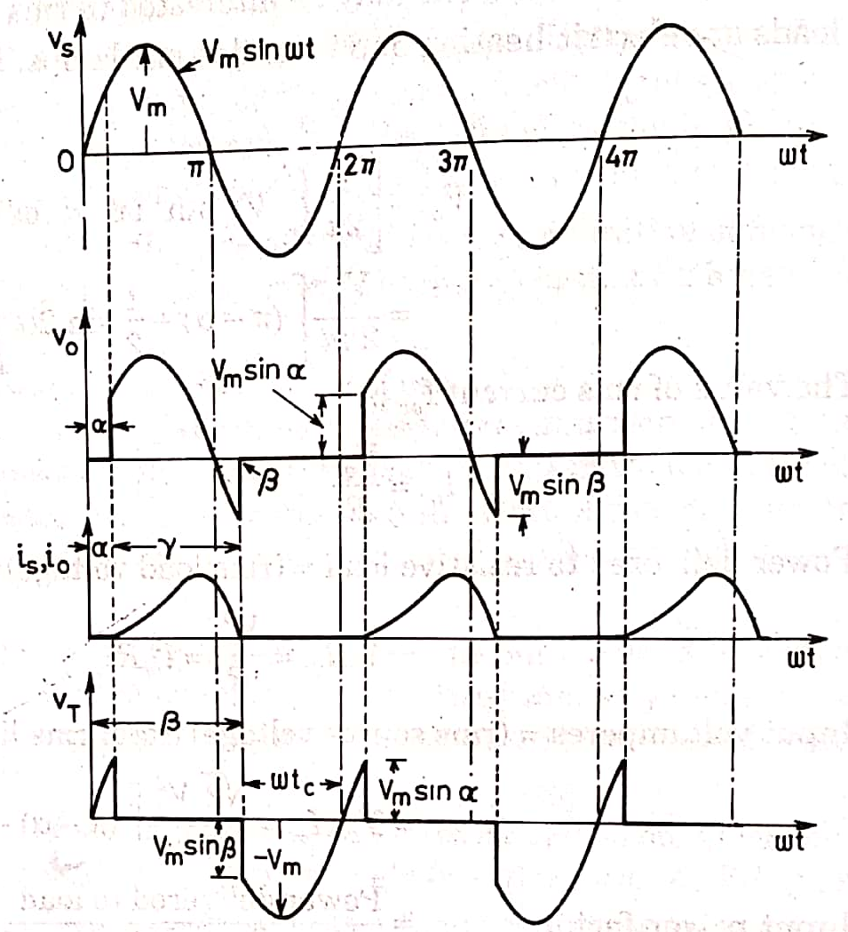
At wt = α, thyristor is turned on by gating signal
The load voltage v_{o} at once becomes equal to source voltage v_{s} as shown.
But the inductance L forces the load, or output, current i_{o}, to rise gradually.
After some time, i_{o} reaches maximum value and then begins to decrease.
At wt = π, V_{o}, is zero but i_{o}, is not zero because of the load inductance L.
After wt =π , SCR is subjected to reverse anode voltage but it will not be turned off as load current i_{o}, is not less than the holding current.

Slide 4
At some angle β>π , io reduces to zero and SCR is turned off as it is already reverse biased.
After wt =β, v_{o}= 0 and i_{o} = 0.
At wt = 2π+ α, SCR is triggered again, v_{o} is applied to the load and load current develops as before.
Angle βis called the extinction angle and (β-α) = γ is called the conduction angle.
voltage equation for the circuit of Fig. when T is on, is

Slide 5
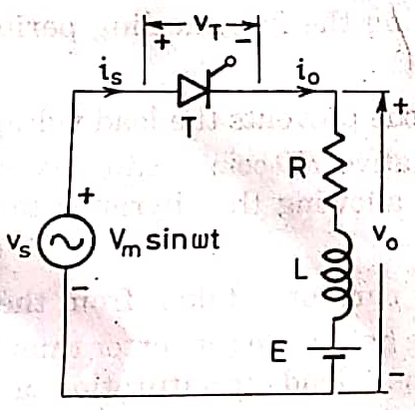
Single-phase Half-wave Circuit with RLE Load
A single-phase half-wave controlled converter with RLE load is shown in Fig.

Slide 6
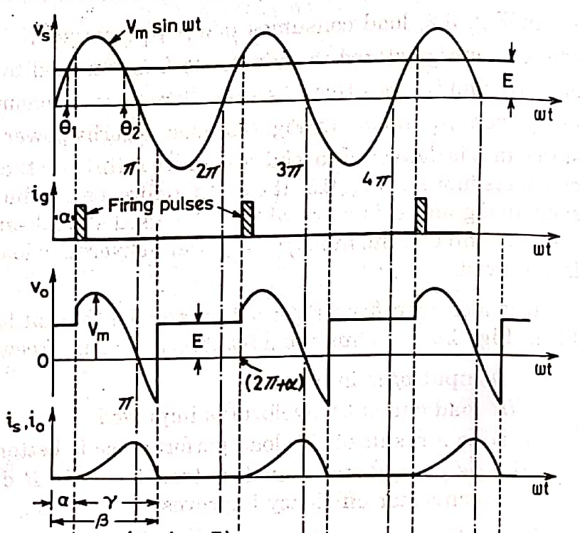
The counter emf E in the load may be due to a battery or a dc motor.
The minimum value of firing angle is obtained from the relation
This is shown to occur at an angle θ₁, in Fig, where
In case thyristor T is fired at an angle α<θ₁, then E>Vs SCR is reverse biased and therefore it will not turn on.
Similarly, maximum value of firing angle is θ₂= π-θ₁,
During the interval load current i_{o}, is zero, load voltage v_{o}= E and during the time io is not zero, vo, follows v_{s} curve.
For the circuit of Fig. with SCR T on, KVL gives the voltage differential equation as

Slide 7
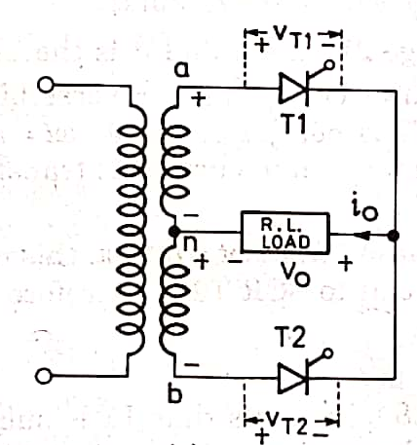
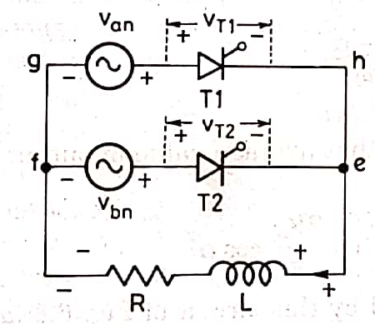
Full-wave Converter with RL load
The circuit diagram of a single-phase full-wave converter using a centre-tapped transformer is shown in Fig.
When terminal a is positive with respect to n, terminal n is positive with respect to b.
Therefore, van = vnb or van = - vbn as n is the mid-point of secondary winding.
Equivalent circuit of this arrangement is shown in Fig.
It is assumed here that load, or output, current is continuous and turns ratio from primary to each secondary is unity.

Slide 8
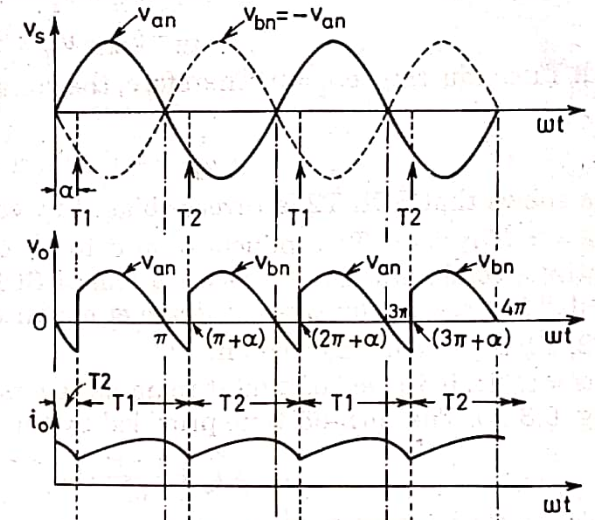
Thyristors T1 and T2 are forward biased during positive and negative half cycles respectively ; these are therefore triggered accordingly.
Suppose T2 is already conducting. After wt = 0, Van is positive, T1 is therefore forward biased and when triggered at delay angle α, T1 gets turned on.
At this firing angle α, supply voltage 2Vmsin α reverse biased T2, this SCR is therefore turned off
Here T1 is called the incoming thyristor and T2 the outgoing thyristor.
As the incoming SCR is triggered, ac supply voltage applies reverse bias across the outgoing thyristor and turns it off.
Load current is also transferred from outgoing SCR to incoming SCR.
This process of SCR turn off by natural reversal of ac supply voltage is called natural or line commutation.

Slide 9
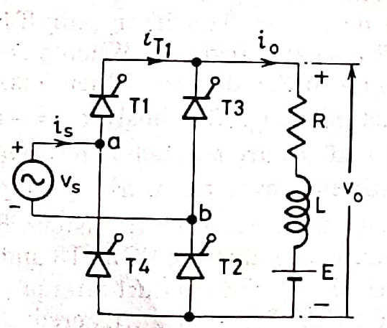
Full-wave Converter with RLE load
A single-phase full converter bridge using four SCRs is shown in Fig.
The load is assumed to be of RLE type, where is the load circuit emf.
Voltage E may be due to a battery in the load circuit or may be generated emf of a dc motor.
Thyristor pair T1, T2 is simultaneously triggered and π radians later, pair T3, T4 is gated together
When a is positive with respect to b, supply voltage waveform is shown as v_{ab} in Fig.
When b is positive with respect to a, supply voltage waveform is shown dotted as v_{ba}.
Obviously, v_{ab} = - v_{ba}
The current directions and voltage polarities shown in Fig. are treated as positive

Slide 10
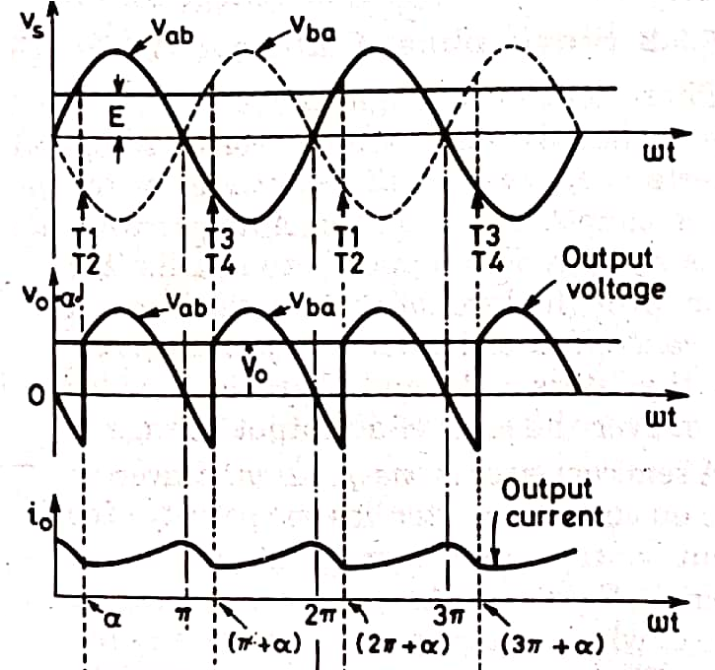
Load current or output current io is assumed continuous over the working range ; this means that load is always connected to the ac voltage source through the thyristors.
Between wt = 0 and wt = α; T1, T2 are forward biased through already conducting SCRs T3 and T4 and block the forward voltage.
For continuous current, thyristors T3, T4 conduct after wt= 0 even though these are reverse biased.
When forward biased SCR T1, T2 are triggered at wt =α, they get turned on.
As a result, supply voltage V_{m}sinα immediately appears across thyristors T3, T4 as a reverse bias, these are therefore turned off by natural, or line, commutation.
At the same time, load current i₀ flowing through T3, T4 is transferred to T1, T2 at wt = α.

Slide 11
Note that when T1, T2 are gated at wt= α, these SCRS will get turned on only if
Thyristors T1, T2 conduct from
wt = α to π+α.
In other words, T1, T2 conduct for π radians.
Likewise, waveform of current i_{T1} through T1 (or i_{T2} through T2) is shown to flow π radians in Fig.
At at wt= π+α, forward biased SCRs T3 ,T4 are triggered.
The supply voltage turns off T1, T2 by natural commutation and the load current is transferred from T1, T2 to T3, T4.

Slide 12
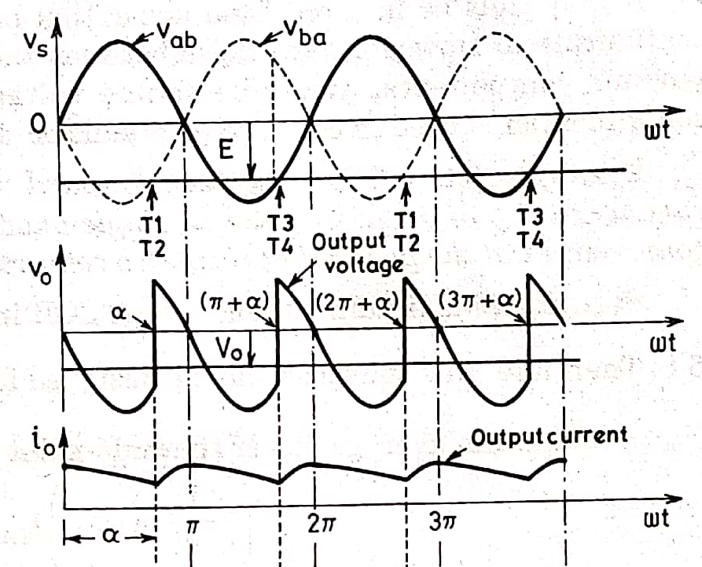
if α > 90°, Vo is negative. This is illustrated in Fig.
Where α is shown greater than 90°. In this figure, average terminal voltage Vo is negative.
If the load circuit emf E is reversed, this source E will feed power back to ac supply.
This operation of full converter known as inverter operation of the converter.
The full converter with firing angle delay greater than 90° is called line-commutated inverter.
During 0 to α, ac source voltage v_{s} is positive but ac source current i_{s} is negative, power therefore flows from dc source to ac source.
From α to π, both v_{s} and i_{s}, are positive, power therefore, flows from ac source to de source.
But the net power flow is from dc source to ac source, because π-α < α in Fig.

Slide 13
In converter operation, the average value of output voltage Vo must be greater than load circuit emf E.
During inverter operation, load circuit emf when inverted to ac must be more than ac supply voltage.
In other words, dc source voltage E must be more than inverter voltage Vo only then power would flow from dc source to ac supply system.
But in both converter and inverter modes, thyristors must be forward biased and current through SCR must flow in the same direction as these are unidirectional devices.
This is the reason output current io is shown positive in Fig.

